Slide 1
Interaction Design & Evaluation

Slide 2
What is interaction design?

Slide 3
What is interaction design?

Slide 4
What is interaction design?

Slide 5
What is interaction design?

Slide 6
What is interaction design?

Slide 7
What is interaction design?

Slide 8
What are these?

Slide 9
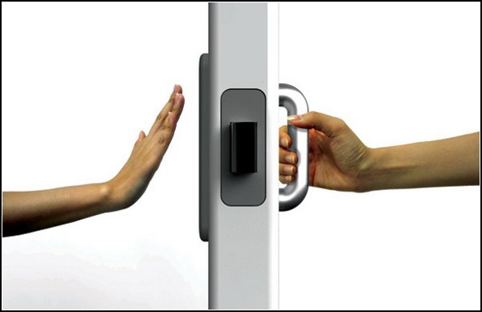

Slide 10
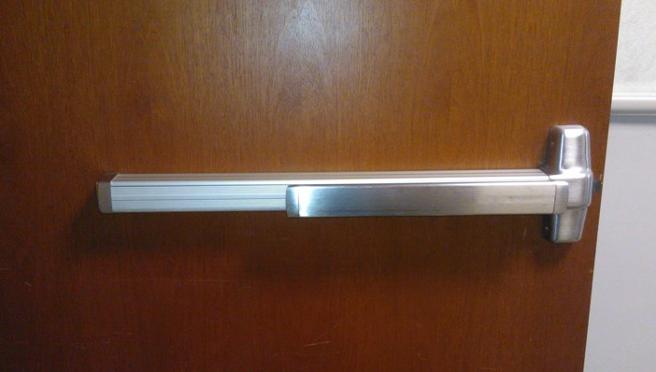

Slide 11
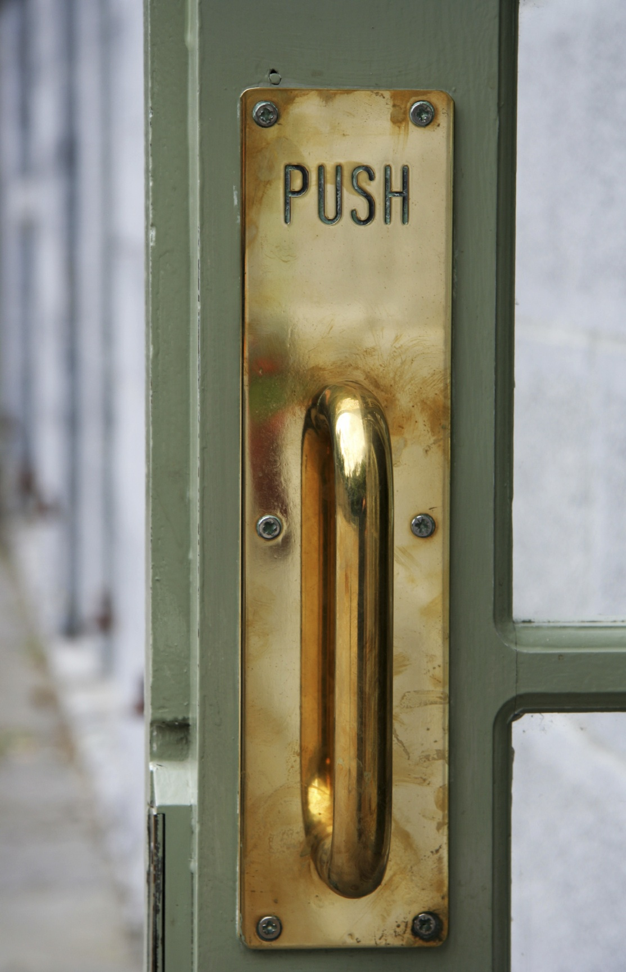

Slide 12
What are some examples of good design?

Slide 13
What are some examples of bad design?

Slide 14
Mystery Object

Slide 15
What did the designers consider?
What does the user want to do?
How would the user interact with it?
Hands, feet
Use a tool
Design cues
Shape, size, color
Labels

Slide 16
Interacting with Computers
Computers: Mouse, keyboard
Tablets: Gestures
Game controllers
Software: buttons, controls, scrollbars, text

Slide 19
Activity
Problem: Create a new game controller to go through a maze
Users: Kindergarten students

Slide 20
How do you know if something is designed well?
Evaluate it!

Slide 21
Usability Testing

Slide 22
What do we measure?

Slide 23
Time on Task

Slide 24
Successful Usage
User easily learned to use the controller
User had some difficulty using the controller, but then figured it out
User did not figure out how to use the controller and needed help

Slide 25
How did using the controller make you feel?

Slide 26
User Preferences
What did you like about the controller?
What did you not like about the controller?

Slide 27
Observations
Did the user need help?
What questions did the user ask?
Did the user complete the maze?
Any facial expressions?
Any mistakes?

Slide 28
A New Controller

